Slide 1
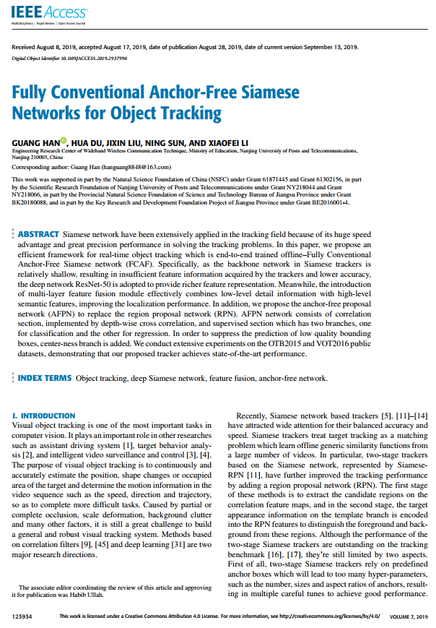

Seminar Presentation (22th August 2020)
Fully Conventional Anchor-Free Siamese Networks
for Object Tracking (FCAF)
Published in IEEE Access-2019
Presented by:
Md. Maklachur Rahman School of Computer Science and Engineering
Kyungpook National University
Republic of Korea

Slide 2
Main Contributions
They introduce fully conventional anchor-free siamese networks for visual tracking.
They considered visual tracking problem as a parallel of classification and regression problem, and thus directly classifies objects and regresses their bounding boxes.
To suppress low quality bounding box prediction, center-ness branch is added.
They introduce multi-layer feature fusion module to combine low-level details information with high-level semantic features effectively to improve the location information.

Slide 3
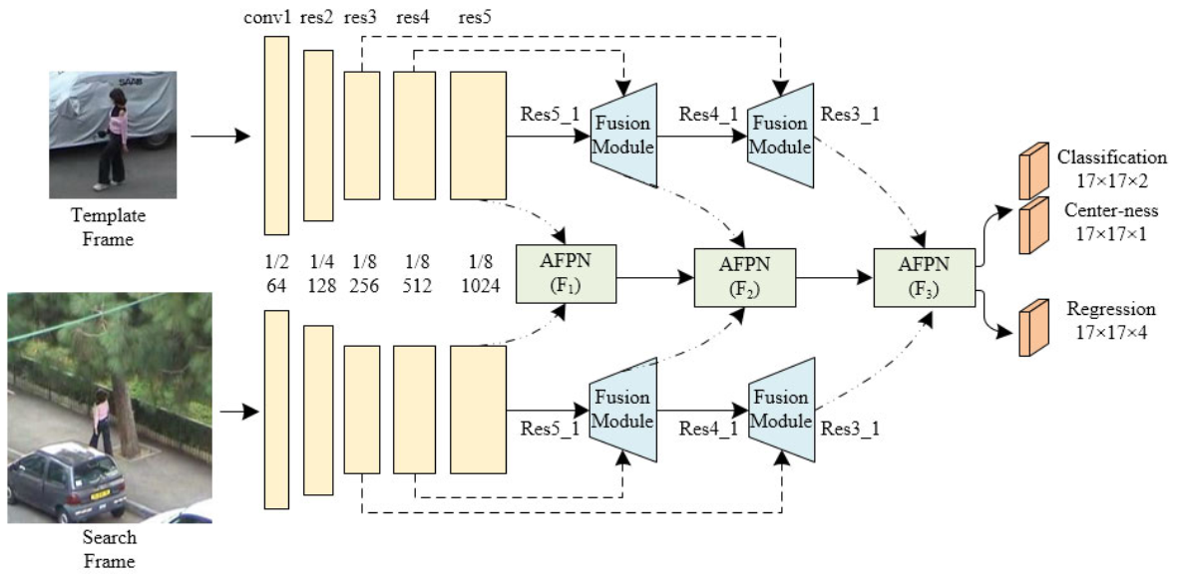
Tracker Framework

Slide 4
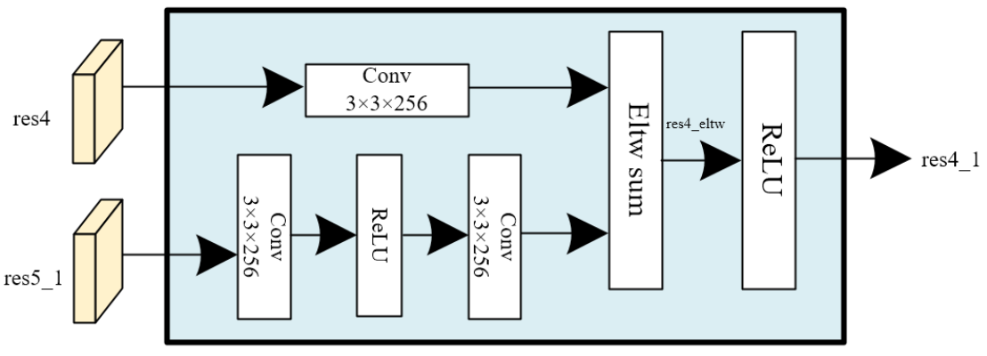
Tracker Framework [continue]

Slide 5
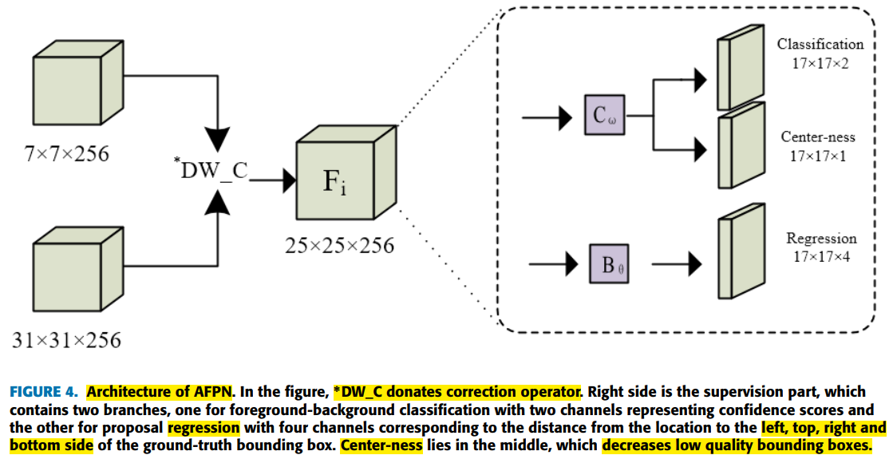
Tracker Framework [continue]

Slide 6
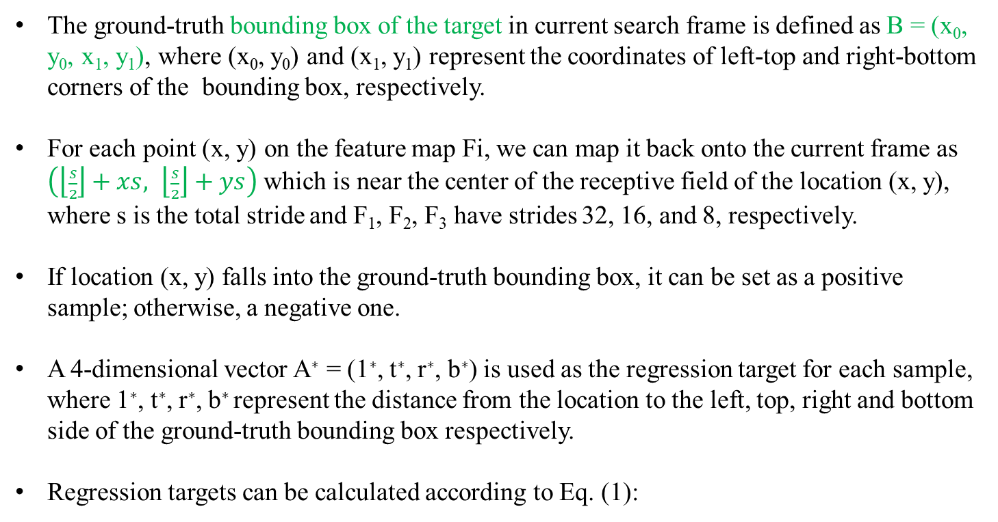
Bounding box regression
The ground-truth bounding box of the target in current search frame is defined as B = (x₀, y₀, x₁, y₁), where (x₀, y₀) and (x₁, y₁) represent the coordinates of left-top and right-bottom corners of the bounding box, respectively.
For each point (x, y) on the feature map Fi, we can map it back onto the current frame as $\left(\left\lfloor \frac{s}{2}\right\rfloor +xs, \left\lfloor \frac{s}{2}\right\rfloor +ys\right)$ which is near the center of the receptive field of the location (x, y), where s is the total stride and F₁, F₂, F₃ have strides 32, 16, and 8, respectively.
If location (x, y) falls into the ground-truth bounding box, it can be set as a positive sample; otherwise, a negative one.
A 4-dimensional vector A∗ = (1∗, t∗, r∗, b∗) is used as the regression target for each sample, where 1∗, t∗, r∗, b∗ represent the distance from the location to the left, top, right and bottom side of the ground-truth bounding box respectively.
Regression targets can be calculated according to Eq. (1):

Slide 7
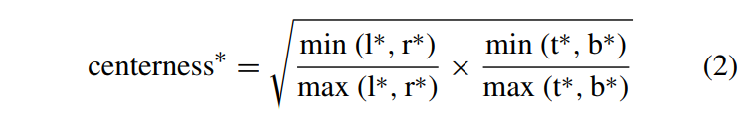
Center-ness branch
To discard the low quality bounding boxes (away from the center of the target), a branch center-ness, parallel to the classification network branch is added to measure the distance between current location and center of the object.
The definition of center-ness with a given regression target (l∗, t∗, r∗, b∗) is shown in Eq. (2):

Slide 8
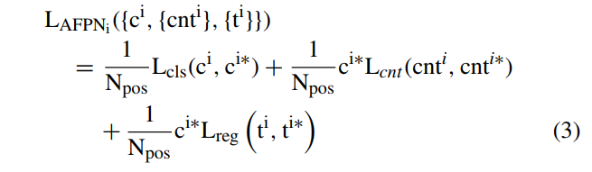

Loss calculation
The loss function of AFPN_{i} consists of the classification loss function L_{cls} (Focal Loss), the center distance loss function L_{cnt} (BCE Loss) and the regression loss function L_{reg} (IOU Loss),
where i is the index of F_{i} and the overall loss is calculated by including every AFPN_{i} as

Slide 9
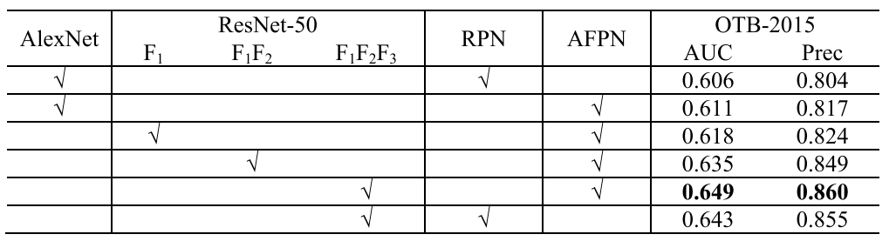
Ablation study on OTB100 benchmark

Slide 10
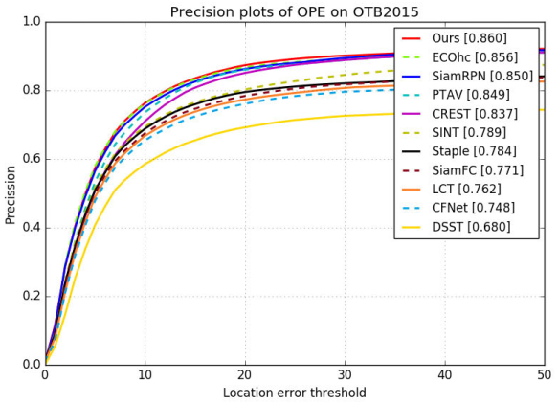
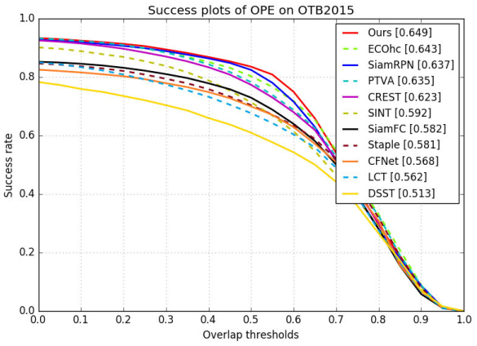
Experimental results on OTB 2015 benchmark
FIGURE 5. Success and precision plots show a comparison with state-of-the-art trackers on the OTB2015 dataset.

Slide 11
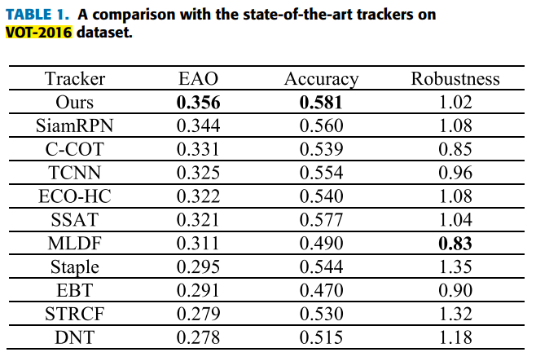
Experimental results on VOT benchmarks

Slide 12
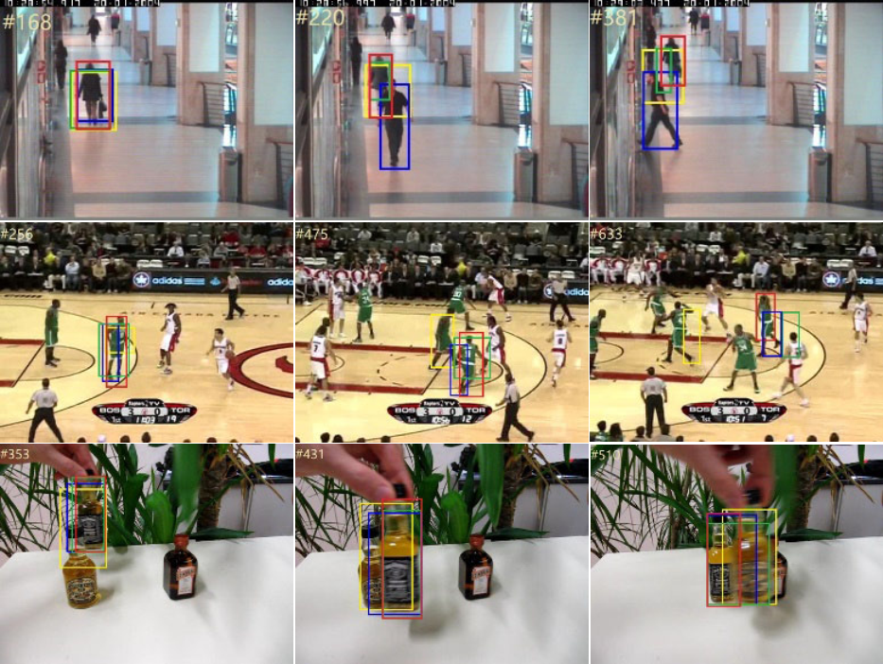
Qualitative comparison
FIGURE 6. Qualitative comparison of the proposed method with other trackers on sequences walking2, basketball, and liquor.

Slide 13
Conclusion
This method directly classifies objects and regresses bounding boxes in a unified network.
Their tracking framewok avoids hyper-parameters that associated with the candidate boxes.
It can achieve state-of-the-art performance and run in real-time that confirms its effectiveness.

Slide 14
감사합니다 (Thank you) Q&A

